Slide 1
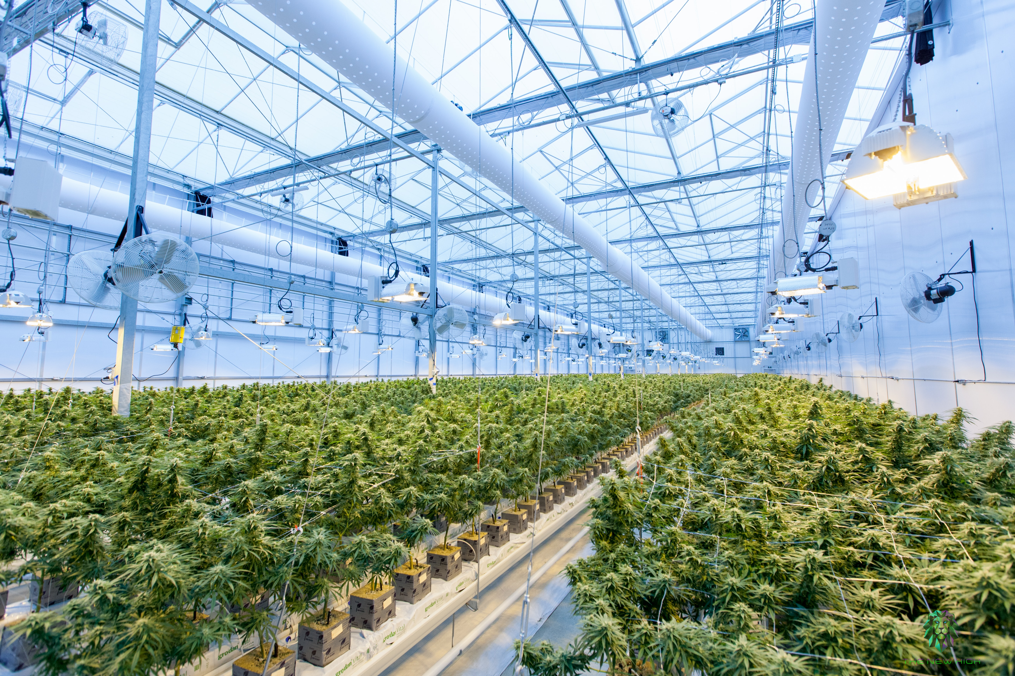

ProDuct Launch

Slide 2
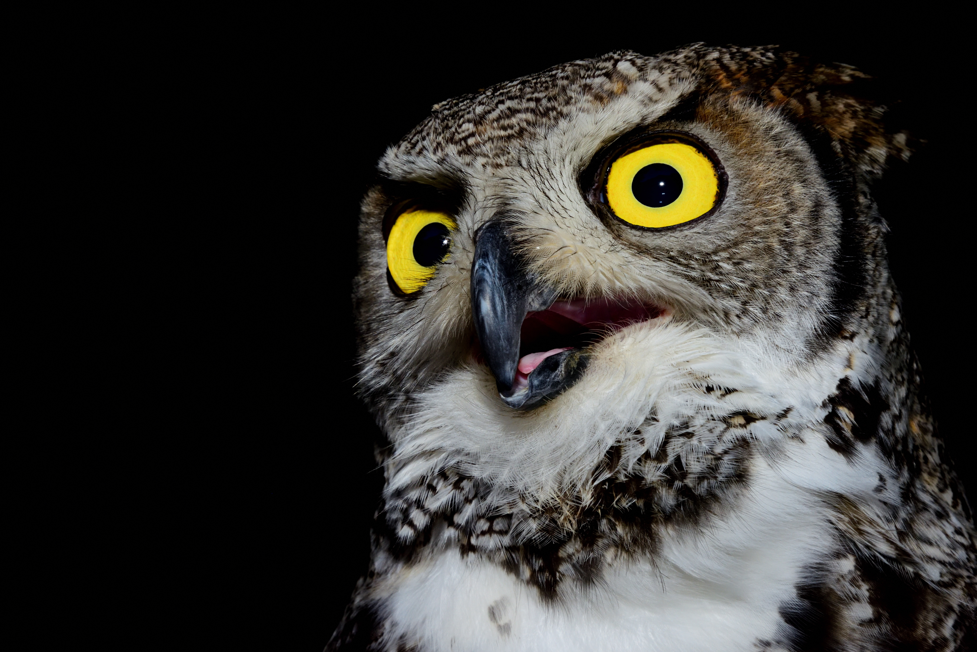
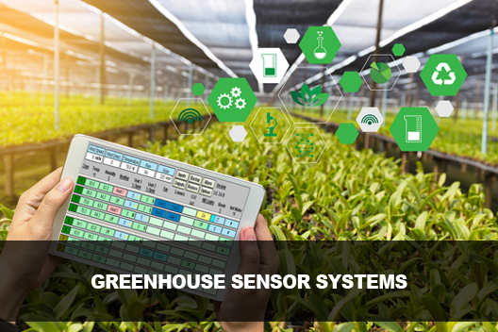

Main IDEA
The objective of this project was to design and implement an automated greenhouse system.
The aim of this system was to optimize the growth conditions for plants by utilizing sensors, actuators, and control algorithms.
8/05/2023 Launch Presentation

Slide 3
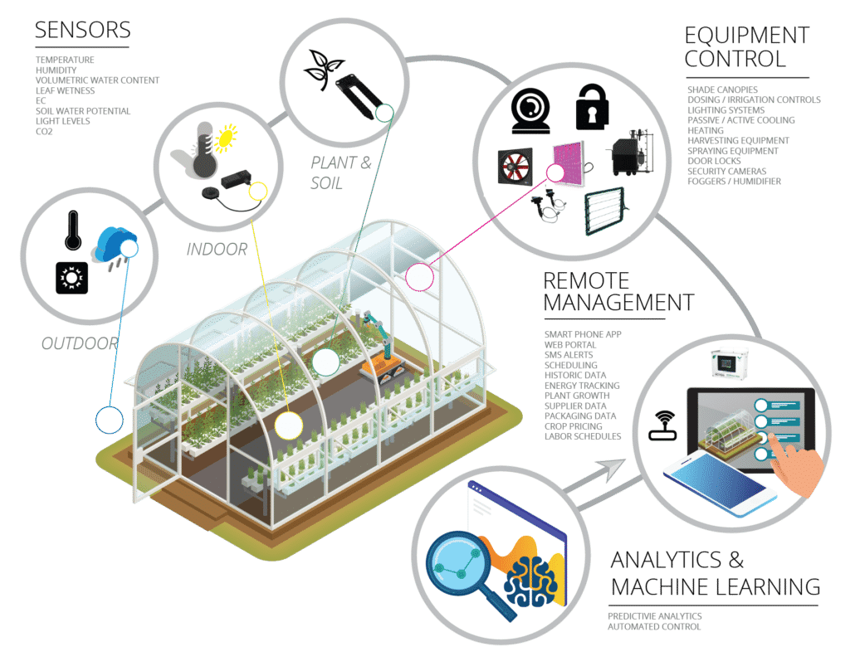

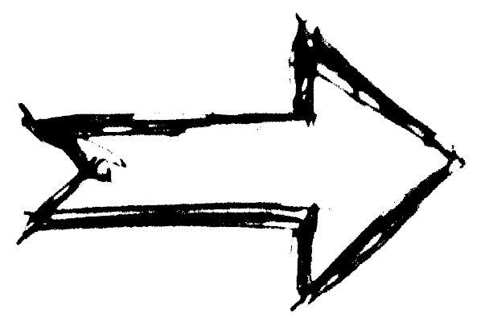
In Detail
- Sensors
Data
- Control
Autonomy
- Analytics
Data
- Actuators
8/05/2023 Launch Presentation

Slide 4
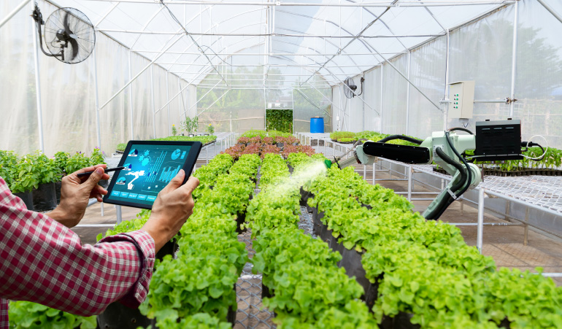
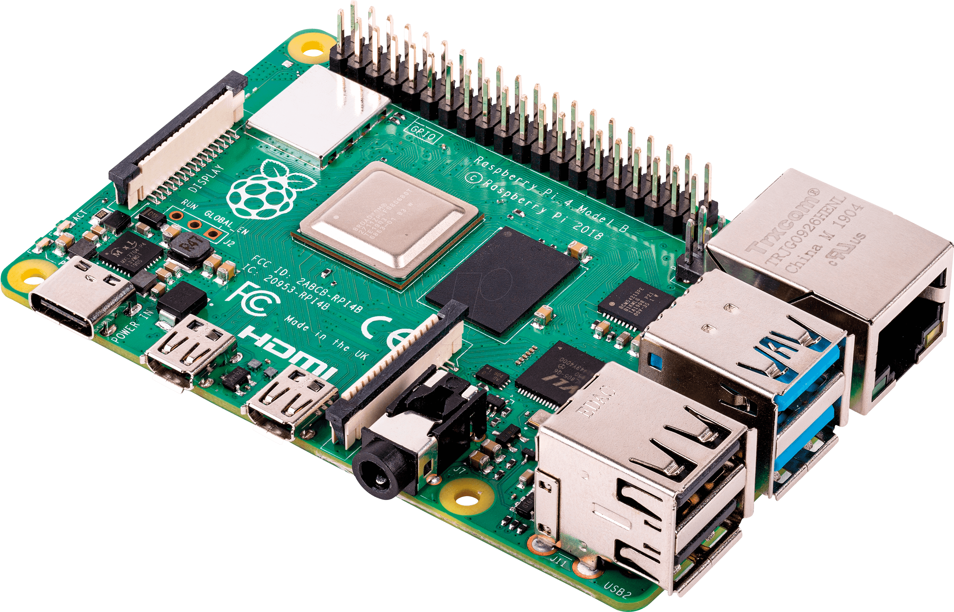
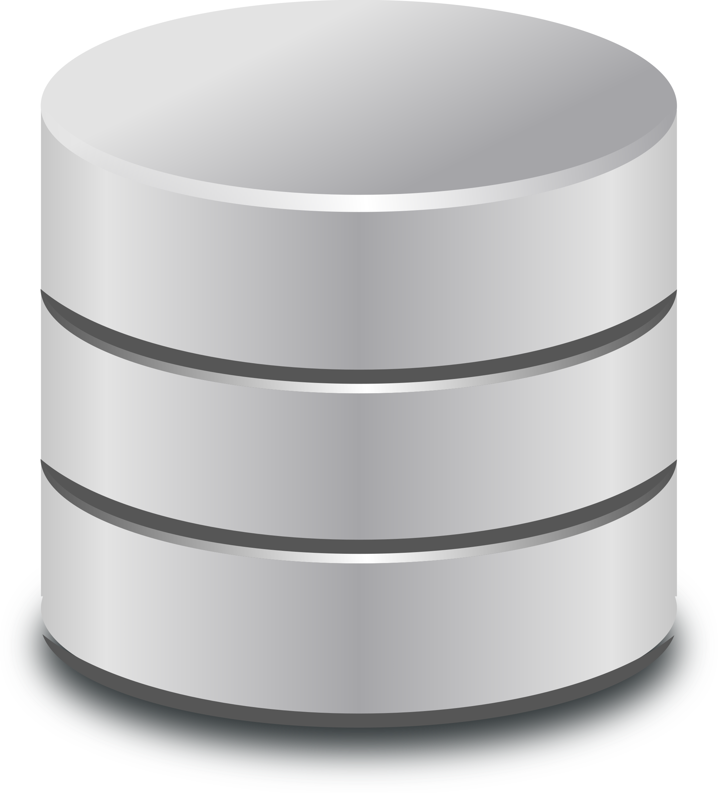
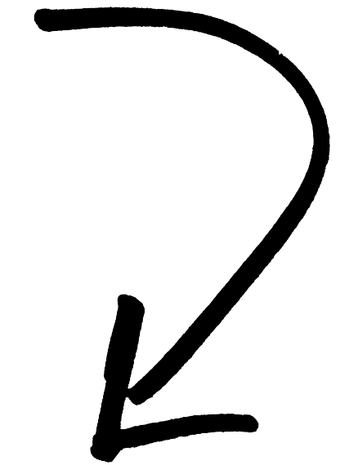
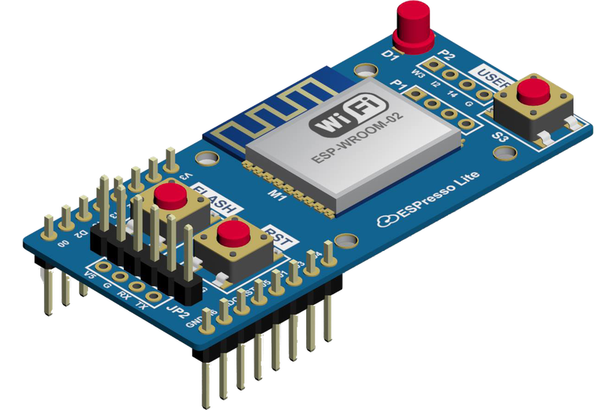
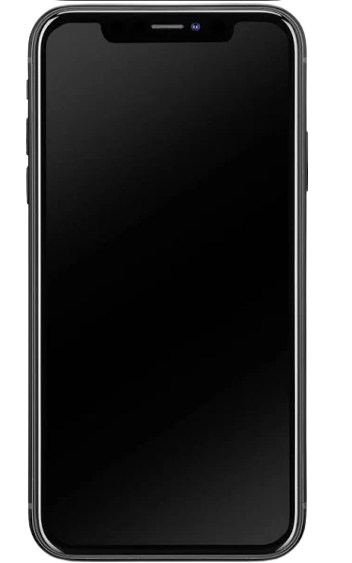
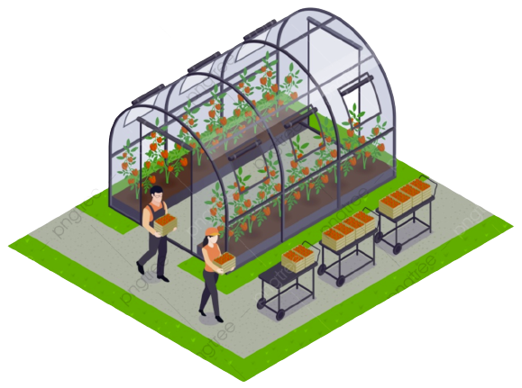

Product Overview
Manage Data
WORKFLOW
Control Center
NodeMCU acts as the interface between the sensors and actuators
Sensors collect data on the conditions inside the greenhouse and send it to the NodeMCU.
The NodeMCU then sends the data to Node-RED, which processes the information and can trigger certain actions based on predetermined conditions.
The processed data from Node-RED is then stored on a Raspberry Pi, where it can be analyzed and mined for valuable insights.
Data Storage
Collect Data
Report
Remote Management
8/05/2023 Launch Presentation

Slide 5
Building the mockup
Starting
Finished

Slide 6
Software Implementation

Slide 7
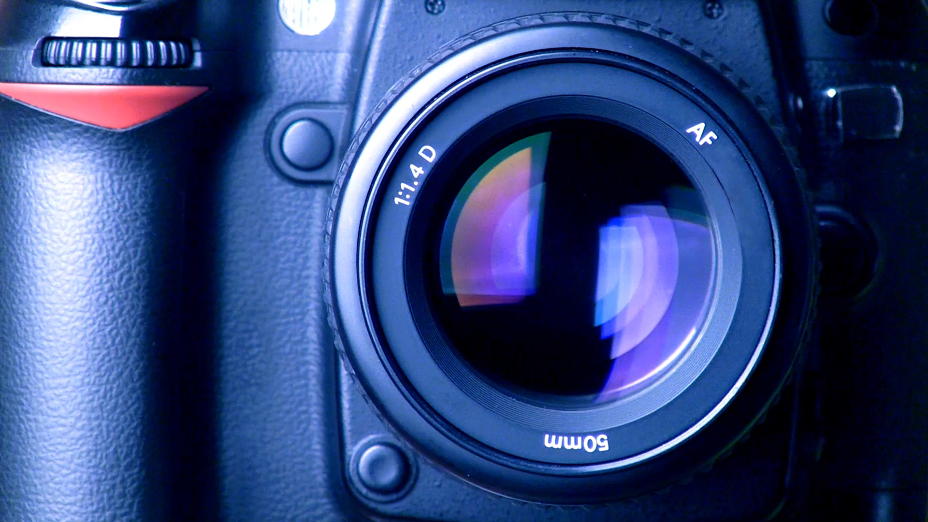
DEMO

Slide 8
Title

Slide 9
Por si quieres añadir alguna más

Slide 10

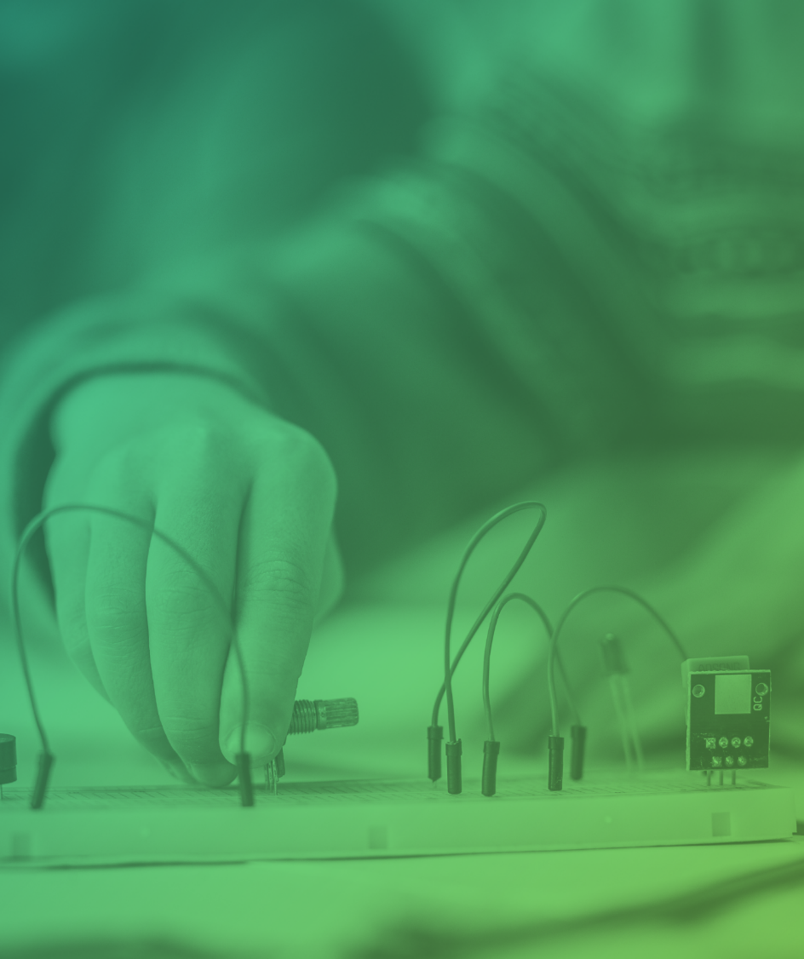
Thank you

